Slide 1
I have utilized SQL queries to solve the questions that are related to Pizza sales
Pankaj Kumar

Slide 2
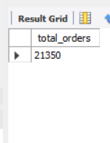
Question 1: Retrieve the total number of orders placed.
SELECT
COUNT(Order_id) AS total_orders
FROM
orders;

Slide 3
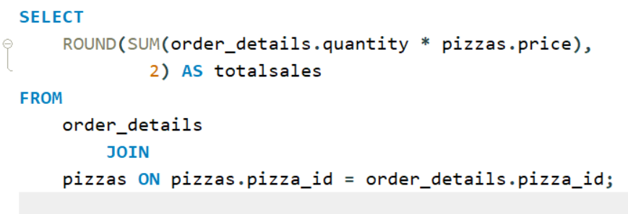
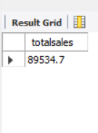
Question 2: Calculate the total revenue generated from pizza sales

Slide 4
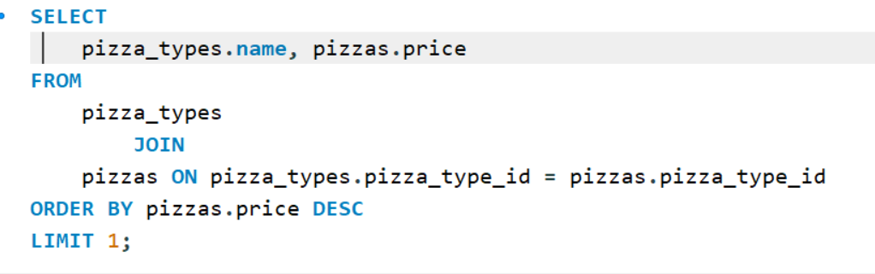
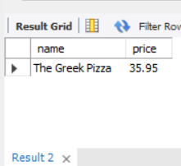
Question 3: Identify the highest-priced pizzas

Slide 5
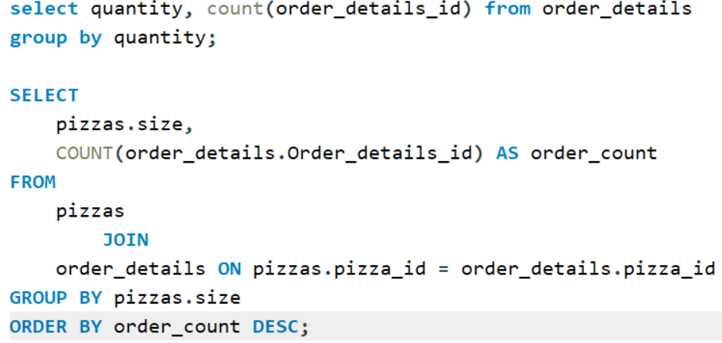
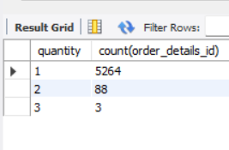
Question 4: Identify the most common pizza size ordered.

Slide 6
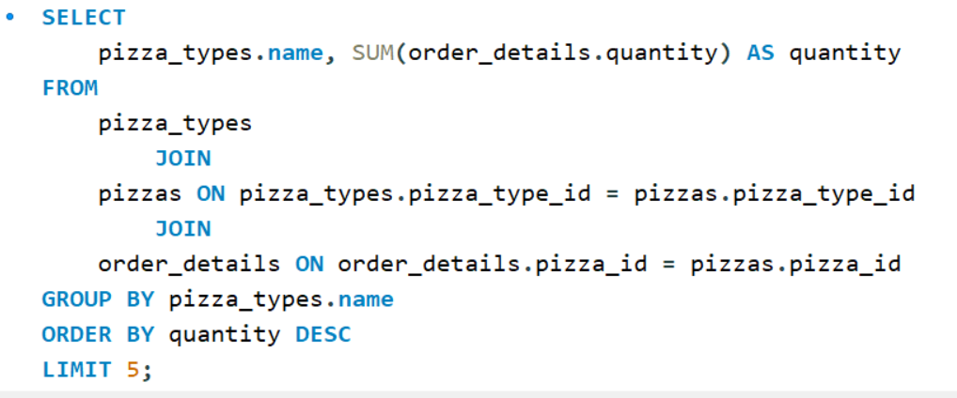
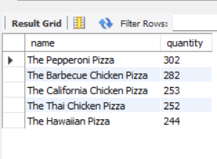
Question 6: List the top 5 most ordered pizza types along with their quantities

Slide 7
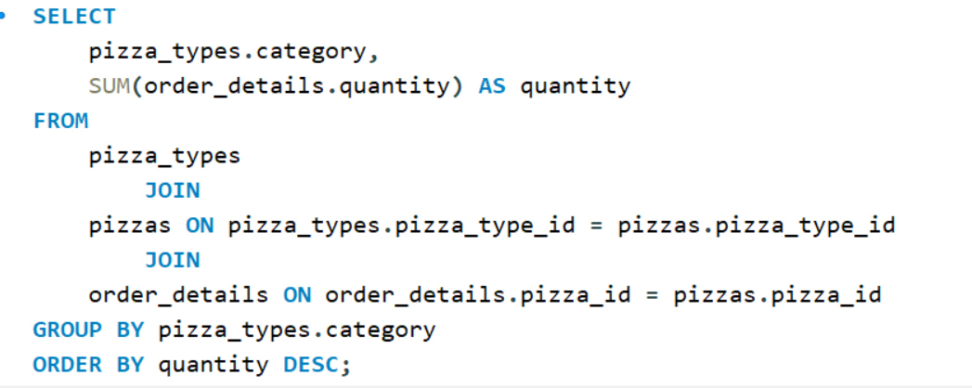
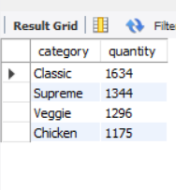
Question 7: join the necessary tables to find the total quantity for each pizza category ordered.

Slide 8
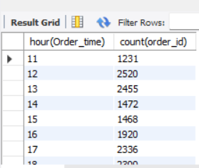
Question 8: determine the distribution of orders by hour of the day.

Slide 9

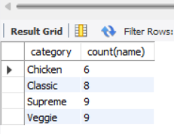
Question 9: join the relevant tables to find the category wise distribution of pizzas

Slide 10
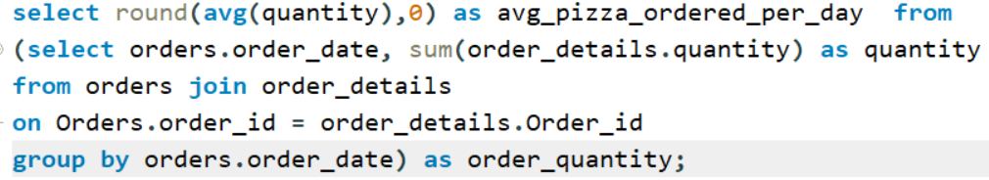
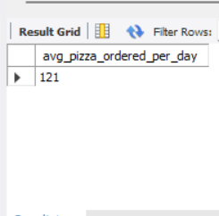
Question 10: Group the orders by date and calculate the average number of pizzas ordered per day.

Slide 11
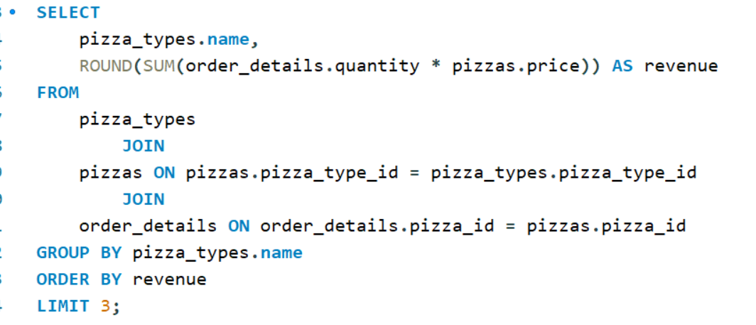
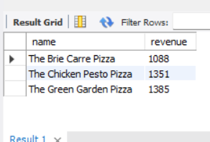
Question 11. Determine the top 3 most ordered pizza types based on revenue

Slide 12
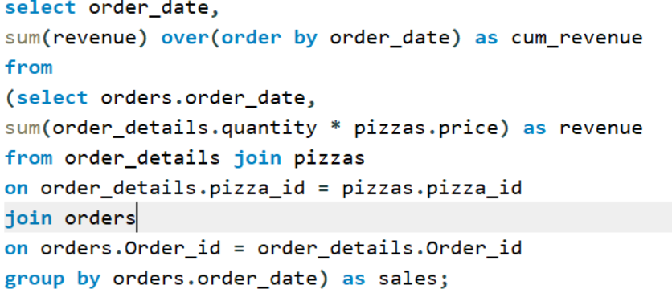
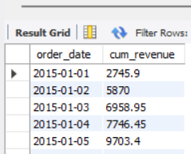
Question 12: Analyse the cumulative revenue generated over time

Slide 13
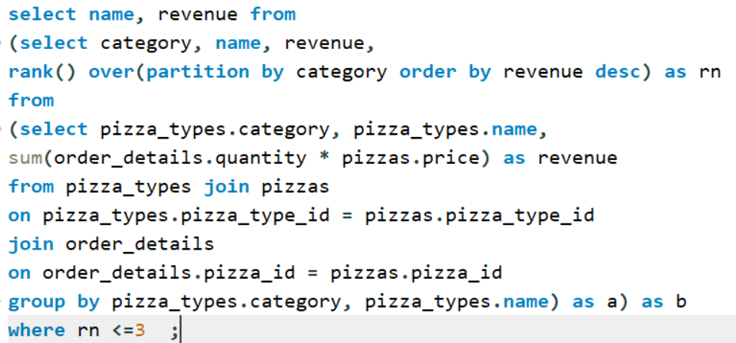
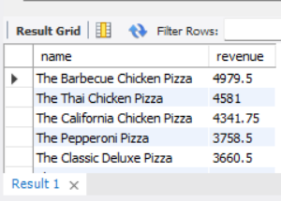
Question 13: Determine the top 3 most ordered pizza types based on revenue for each pizza category.

